Slide 1


THE BETTER POLICY PROJECT
AI-POWERED LEARNING
WEEK 1 · DAY 3
QPMs
Semi-Structural Quarterly Projection Models
01
The Workhorse QPM
Economic structure built for central bank policy analysis
02
Unobserved Variables & Judgment
Potential output, r*, NAIRU, expectations
03
Sticky-Price Inflation Framework
The core of credibility measurement
Chulalongkorn University · Bangkok, Thailand · June 10, 2026

Slide 2




Week 1 · Day 3 · QPMs
DAY 3 · WEDNESDAY, JUNE 10, 2026
What You'll Learn Today
Where economics meets the data — and where judgment meets the model
QPM architecture
Unobserved variables
The four core equations: output gap, Phillips curve, policy rule, and exchange rate.
Why potential output, r*, and NAIRU must be estimated — and why judgment is essential.
Sticky & flexible prices
Calibration & scenario design
Why sticky-price inflation is the right lens for policy credibility.
How model parameters are tailored to a country and set up for Case A/B scenarios.
www.thebetterpolicyproject.org
www.ai-powered-learning.org
2

Slide 3
Week 1 · Day 3 · QPMs
DAY 3 · WEDNESDAY, JUNE 10, 2026
Why Semi-Structural?
The pragmatic middle ground — economic content without unmanageable complexity
PURE TIME SERIES
SEMI-STRUCTURAL QPM
FULL DSGE
VAR / Black Box
The Workhorse
Structural but Heavy
Forecasts without structural interpretation
No clear role for policy or credibility
Hard to tell scenario stories
Small set of behaviorally-meaningful equations
Clear economic interpretation
Built for policy trade-off analysis
Tractable for monthly/quarterly cycles
Strong microfoundations
Useful for welfare & deep analysis
Slow to run; risk of misspecification
Harder to operate in a policy cycle
QPMs give forecasting teams economic content they can defend — and simplicity they can actually run every cycle.
www.thebetterpolicyproject.org
www.ai-powered-learning.org
3

Slide 4


Nonlinear policy analysis · MCP
Mixed Complementarity Problem (MCP) Ingredients
The policy problem assembled from three pieces — solved jointly with occasionally-binding constraints
INGREDIENT 01
INGREDIENT 02
INGREDIENT 03
Loss Function Minimization
Linear + Nonlinear Equations
Occasionally-Binding Constraints
The central bank chooses policy to minimize a weighted sum of deviations — inflation from target, output from potential, and changes in the policy rate.
The economy is a system of linear and nonlinear equations — including a convex Phillips curve and endogenous policy credibility that responds to performance.
Nasty constraints enter and exit — most prominently the effective lower bound on interest rates — requiring complementarity-style solution methods.
Solved jointly as a Mixed Complementarity Problem — the right tool for kinked policy rules and active ELB constraints.
www.thebetterpolicyproject.org
www.ai-powered-learning.org
4

Slide 5
Week 1 · Day 3 · QPMs
DAY 3 · WEDNESDAY, JUNE 10, 2026
Four Core QPM Equations
A small, coherent system that captures the transmission mechanism
01
Output Gap (IS)
Aggregate demand responds to the real interest rate gap and real exchange rate gap.
y gap = ρ · y gap(−1) − β · (r − r*) + γ · (z − z*)
02
Phillips Curve
Inflation driven by expectations, inertia, and the output gap. Sticky/flexible split applies here.
π = α · Eπ + (1−α) · π(−1) + λ · y gap + ε π
03
Policy Rule (Taylor-type)
The central bank reacts systematically to inflation and output gaps, with smoothing.
i = φ · i(−1) + (1−φ) · [ i* + θπ · (π−π̄) + θy · y gap ]
04
Risk-Adjusted UIP
Exchange rate dynamics link domestic policy, foreign rates, and country risk premium.
i = Δs + i* + ρ
www.thebetterpolicyproject.org
www.ai-powered-learning.org
5

Slide 6

Week 1 · Day 3 · QPMs
DAY 3 · WEDNESDAY, JUNE 10, 2026
Unobserved Variables
The starred quantities — y*, r*, u*, π* — are estimated, not measured. Judgment is essential.
KEY UNOBSERVABLES
y*
Potential output
WHY JUDGMENT MATTERS
Economy's non-inflationary capacity
r*
Neutral interest rate
Estimates change with every vintage
Rate consistent with stable inflation
No filter or model can identify these from data alone — priors and structural assumptions matter
Potential output revisions can flip a positive output gap to negative — policy implications shift overnight
r* is inherently contested; different methods disagree by hundreds of basis points
Mark II makes these priors explicit and tests robustness across scenarios
u*
NAIRU
Unemployment consistent with stable inflation
ρ
Country risk premium
Wedge between domestic and foreign yields
Eπ
Inflation expectations
Forward-looking behavior of price-setters
www.thebetterpolicyproject.org
www.ai-powered-learning.org
6

Slide 7
MCP · Ingredient 01
Monetary Policy Loss Function
The central bank minimizes a discounted sum of three quadratic terms
Loss = Σ [ 1.0·(π4_{t+i} − π*)² + 1.0·y²_{t+i} + 0.5·(rs_{t+i} − rs_{t+i−1})² ]
Summed over i = 0 to ∞
Under IT, target deviations are costly
Avoid output deviations
Inflation deviations from π* are penalised — because under inflation targeting, the target is the nominal anchor.
Penalising y²_t minimises the amplitude of the business cycle and prevents prolonged gaps in either direction.
Gradualism in policy rates
Asymmetric response (despite symmetric loss)
Penalising changes in the real rate (rs − rs_(−1)) reflects aversion to sharp movements and strengthens expectations channel.
Even though the loss function is symmetric, endogenous credibility produces stronger responses to overshoots than undershoots.
www.thebetterpolicyproject.org
www.ai-powered-learning.org
7

Slide 8
MCP · Ingredient 02 (a)
Expectations-Augmented Phillips Curve
Inflation driven by expectations, inertia, and a nonlinear output-gap effect
π_{t} = λ₁ · π4e_{t} + (1 − λ₁) · π4_{t−1} + λ₂ · [ y_{t−1} · y_{max} / (y_{max} − y_{t−1}) ] + ε^{π}_{t}
Non-linear output gap effect
Calibration: λ₁ = 0.70, λ₂ = 0.10, y_max = 6.0
WHERE
π4^e_t — Inflation expectations
π4_(t−1) = (1/4) Σ π_(t−i) — Backward-looking component of inflation (4-quarter average)
y_(t−1) — Output gap in period t−1
y_max — Maximum output gap possible before inflation explodes
www.thebetterpolicyproject.org
www.ai-powered-learning.org
3

Slide 9
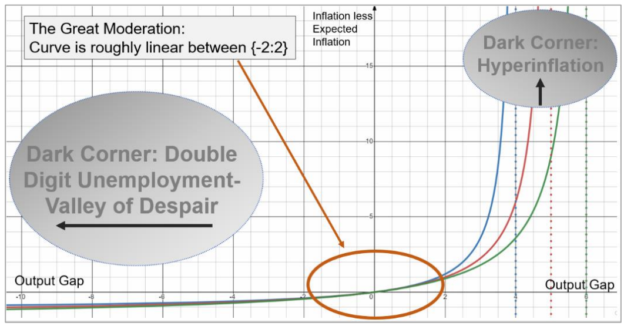
MCP · Ingredient 02 (a)
Convex Phillips Curve — Different y_max Values
Non-linear output-gap effect: as y → y_max, the inflation response explodes into the dark corner
DARK CORNER · LEFT
Double-Digit Unemployment
Valley of despair — large negative gaps, deflationary pressure, monetary policy loses traction at the ELB.
DARK CORNER · RIGHT
Hyperinflation
Capacity constraints bind hard; small further overheating triggers sharp, explosive inflation.
GREAT MODERATION
Curve is roughly linear between {−2 : 2} — this is where policy usually operates.
www.thebetterpolicyproject.org
www.ai-powered-learning.org
9

Slide 10
Endogenous credibility · Step 1
Inflation Regimes and CB Performance
Two hypothetical regimes — a Low-inflation anchor and a High-inflation drift
LOW INFLATION REGIME (L)
HIGH INFLATION REGIME (H)
Convergence to the π* target
Convergence to a higher level (10%)
π4^{L}_{t} = Γ^{L} · π4_{t−1} + (1 − Γ^{L}) · π* + ε^{πL}_{t}
π4^{H}_{t} = Γ^{H} · π4_{t−1} + (1 − Γ^{H}) · 10 + ε^{πH}_{t}
Γ^L = 0.5, π* = 2
Γ^H = 0.9
CENTRAL BANK PERFORMANCE INDICATOR
η_{t} = (π4^{H}_{t} − π4_{t})² / [ (π4^{H}_{t} − π4_{t})² + (π4^{L}_{t} − π4_{t})² ]
η_{t} = 1 in the "L" case · η_{t} = 0 in the "H" case
www.thebetterpolicyproject.org
www.ai-powered-learning.org
5

Slide 11


Measuring credibility · Step 2
Why Sticky Prices?
Credibility is a reflection of performance — and sticky prices are the cleanest signal
REASON 01
REASON 02
REASON 03
Anchoring long-term expectations
The price-setting signal
Non-tradeable services (haircuts)
Sticky prices are "best" for thinking about how well central banks have been anchoring long-term inflation expectations and managing the short-run output-inflation trade-off.
They better reflect the type of prices that are most relevant to central bankers — because they contain information on the underlying price-setting behaviour of the entire economy.
In a broad sense, sticky prices are the components of the CPI basket that are non-tradeable services. The commonly used example is haircut prices — a non-traded service that requires domestic labour to produce.
We construct the Central Bank Sticky Price Inflation Indicator (CBSPII) — the basis for measuring performance.
www.thebetterpolicyproject.org
www.ai-powered-learning.org
11

Slide 12
Week 1 · Day 3 · QPMs
DAY 3 · WEDNESDAY, JUNE 10, 2026
Sticky vs Flexible Price Inflation
Not all prices tell central banks the same thing — split the CPI to read credibility correctly
FLEXIBLE PRICES
STICKY PRICES
Fast-moving, noisy, weakly informative
Slow-moving, persistent, highly informative
Tradeable goods, commodities, energy, food
Driven by global prices, exchange rate, weather
Large, frequent, often transitory movements
Reading headline inflation alone can mislead policy
Non-tradeable services (rent, haircuts, insurance, education)
Reflect underlying price-setting behaviour of the economy
Persistence reveals how well expectations are anchored
The right signal for credibility — used in CBSPII measurement
www.thebetterpolicyproject.org
www.ai-powered-learning.org
12

Slide 13
US Sticky Price Inflation · Core vs Non-Traded
US Core Sticky & Non-Traded Sticky Price Inflation
3-month-over-3-month annualized · 1967–2026 · key episodes shaded
Volcker disinflation
COVID surge
Source: Federal Reserve Bank of Atlanta, Core Sticky Price CPI (monthly). Non-Traded Sticky = sticky items with tradeable goods removed (services-focused). 3M-o-3M annualized rate, Feb 1967–Mar 2026.
www.thebetterpolicyproject.org
13
www.ai-powered-learning.org

Slide 14
US Sticky Price Inflation · Recent
The Post-COVID Episode, 2015–2026
Core sticky and non-traded sticky — both surged, both still moderating toward 2%
COVID
Post-COVID surge
CORE STICKY
Peaked near 7%
The broadest sticky-price measure hit 6.9% in Aug 2022 — the highest rate since the early 1980s.
NON-TRADED STICKY
Peaked at 6.1%
Stripping out tradeable goods gives a services-heavy view — still tracking above 2% in 2026.
BOTH
Still above target
As of early 2026, both series remain above the 2% target — the classic FPAS-II credibility test.
Source: Federal Reserve Bank of Atlanta, Core Sticky Price CPI (monthly). Non-Traded Sticky = sticky items with tradeable goods removed. 3M-o-3M annualized.
www.thebetterpolicyproject.org
14
www.ai-powered-learning.org

Slide 15
Measuring credibility · Step 3
Constructing the Credibility Index — CBCSI
From performance η_t to the Central Bank Credibility Stock Index γ_t
CREDIBILITY STOCK
γ_{t} = ρ · γ_{t−1} + (1 − ρ) · η_{t−1} + ε^{γ}_{t}
ρ = 0.10 → credibility accumulates slowly; it's a stock, not a flow.
FORMATION OF EXPECTATIONS
π4e_{t} = C_{t} · π4_{t+4} + (1 − C_{t}) · π4_{t−1} + b_{t} + ε^{πe}_{t}
with inflation-expectation bias b_{t} = 0.1 · (1 − C_{t})
C_t ∈ [0, 1]
High credibility
Low credibility
Credibility is bounded. 1 = fully anchored, 0 = no trust.
Agents put more weight on the target — expectations stay anchored.
Agents weight past inflation more; bias b_t grows.
www.thebetterpolicyproject.org
www.ai-powered-learning.org
15

Slide 16
Week 1 · Day 3 · QPMs
DAY 3 · WEDNESDAY, JUNE 10, 2026
Output Gap: The Hardest Unobservable
Potential output estimates drive policy recommendations — and they move with every data vintage
IMPLICATIONS FOR POLICY
01
Sign of the output gap can flip with revisions
The same GDP path is inflationary or disinflationary depending on potential.
02
Policy rules amplify this uncertainty
Small changes in y* translate directly into different rate recommendations.
03
Scenario approach is the response
Run Case A/B with alternative y* assumptions — don't commit to one estimate.
www.thebetterpolicyproject.org
www.ai-powered-learning.org
16

Slide 17
Week 1 · Day 3 · QPMs
DAY 3 · WEDNESDAY, JUNE 10, 2026
Calibration Workflow
From the literature to a country-specific model — with scenario design baked in
01
02
03
04
Anchor
Match moments
Stress test
Design scenarios
Start from literature priors and the country's institutional features (FX regime, openness, financial depth).
Tune parameters so model impulse responses and volatilities match stylized facts.
Run historical shocks through the model — does it reproduce known episodes?
Set up Case A / Case B / Market Ref around shared priors, with explicit uncertainty in y* and r*.
Tomorrow — Day 4 — we move this calibrated model into DynareJulia and run the first scenario simulations.
www.thebetterpolicyproject.org
www.ai-powered-learning.org
17

Slide 18

Week 1 · Day 3 · QPMs
DAY 3 · WEDNESDAY, JUNE 10, 2026
Discussion & Wrap-up
Questions to prepare for tomorrow's DynareJulia implementation
KEY TAKEAWAYS FROM TODAY
Semi-structural QPMs sit between atheoretical VARs and heavy DSGEs — enough economics, enough speed.
Four core equations — output gap, Phillips curve, policy rule, UIP — carry most of the policy content.
Unobservables (y*, r*, u*, Eπ) cannot be read off the data; judgment and priors are part of the model.
Sticky-price inflation is the right signal for credibility — flexible prices add noise, not information.
DISCUSSION QUESTIONS
How is potential output estimated in your institution today — and how often does it get revised?
Does your current policy rule give more weight to inflation or to the output gap? How would you defend that?
Which sticky-price indicator would you build for your economy, and what data constraints would you face?
If you had to pick one Case A / Case B pair for next quarter, what would differ across them?
www.thebetterpolicyproject.org
www.ai-powered-learning.org
18

